Slide 1
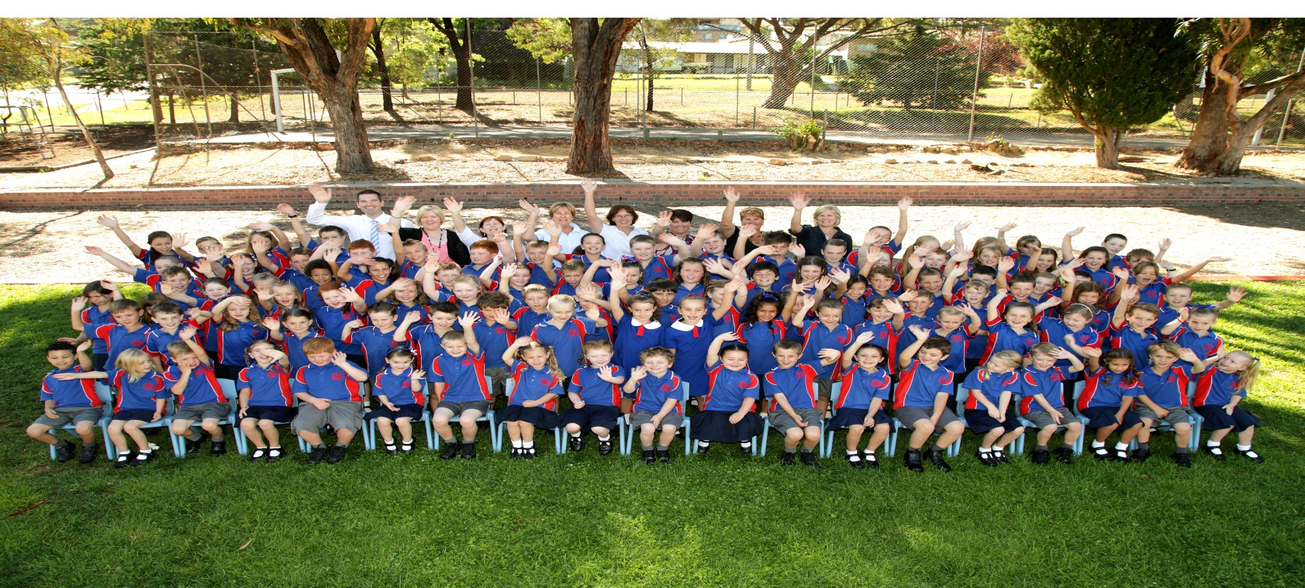
A tour of Goulburn East Public School
Please click Slide Show – From Beginning

Slide 2
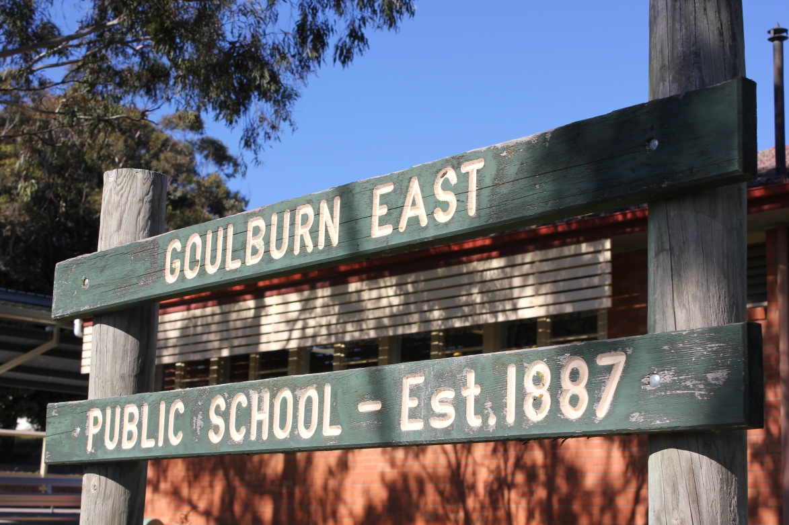
Our school was first opened in 1887. We are one of the oldest schools in Goulburn. This picture is taken from the Park Rd side of the school, near the line of Remembrance trees leading to Rocky Hill War Memorial.

Slide 3
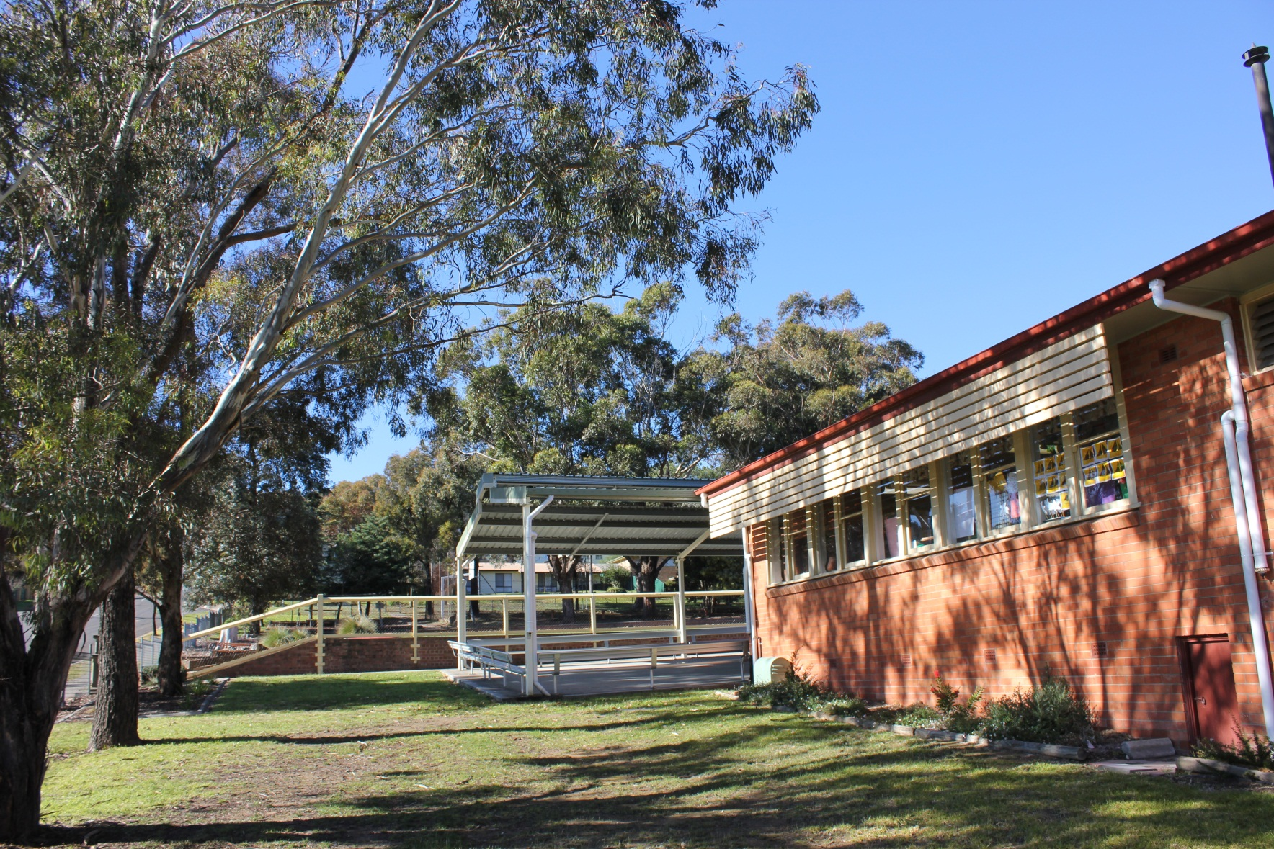
This picture shows the Kindergarten class and part of our Outdoor Covered Learning Area (via Park Rd).

Slide 4
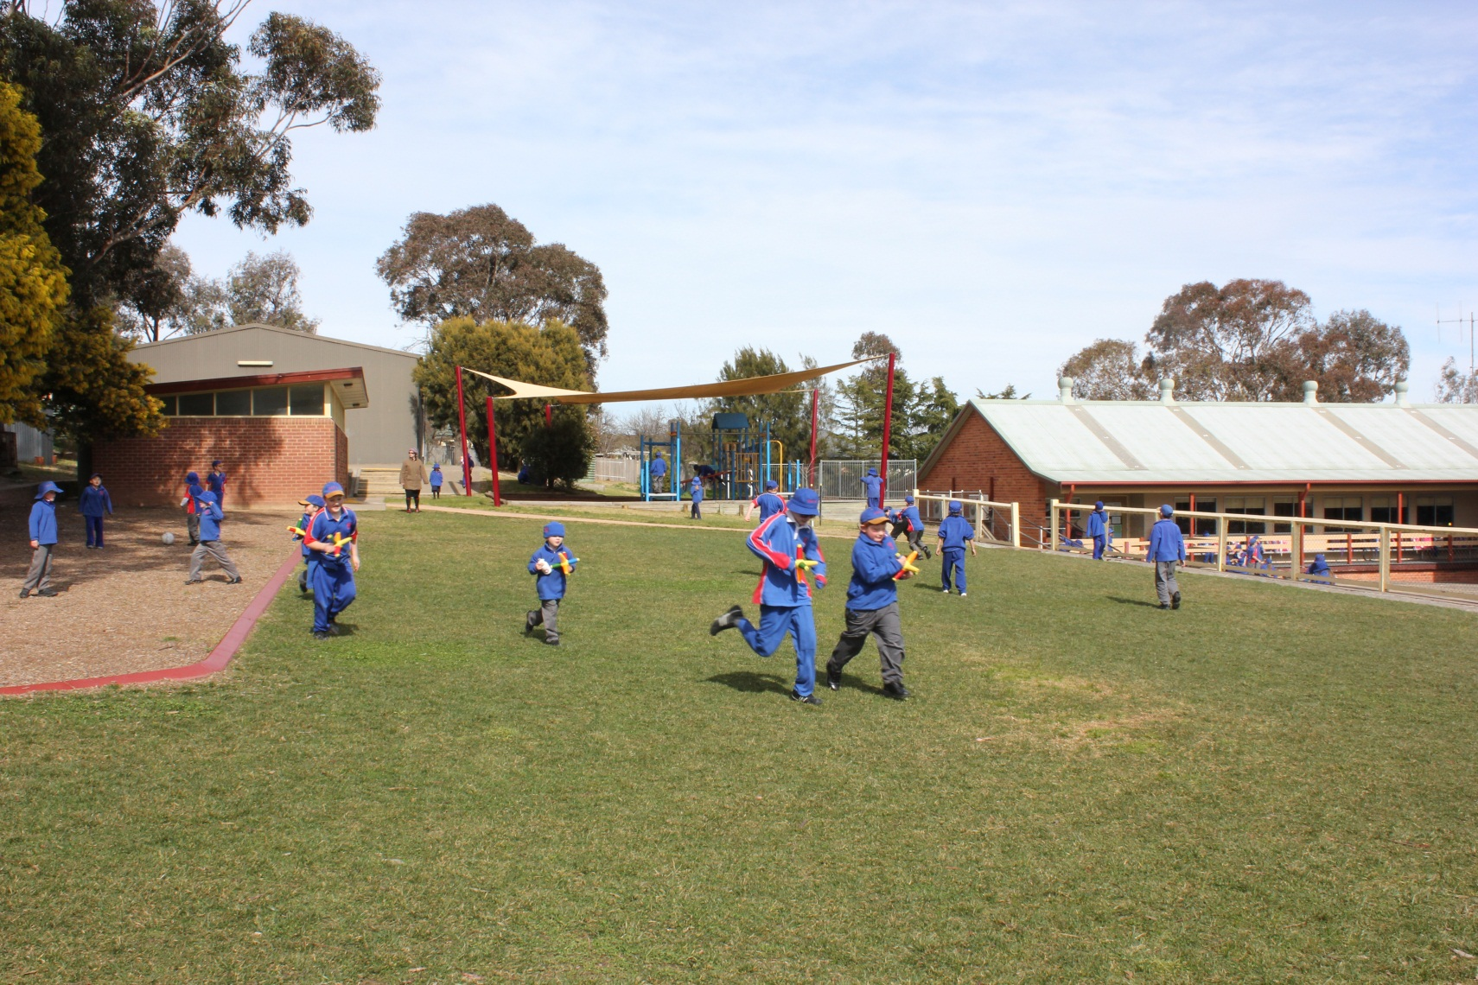
Here we have our top play area. The grounds have a fully automated sprinkler system keeping our turf green all year round. The bottom building (with the green roof) houses two classrooms and our computer lab.

Slide 5
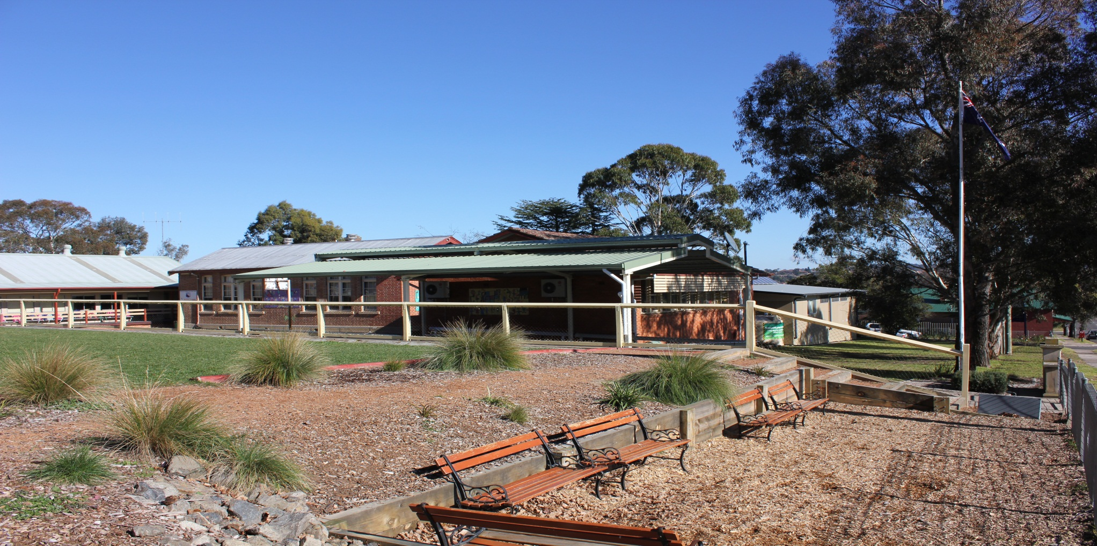
This is our sitting area (it also houses our special fairy garden).

Slide 6
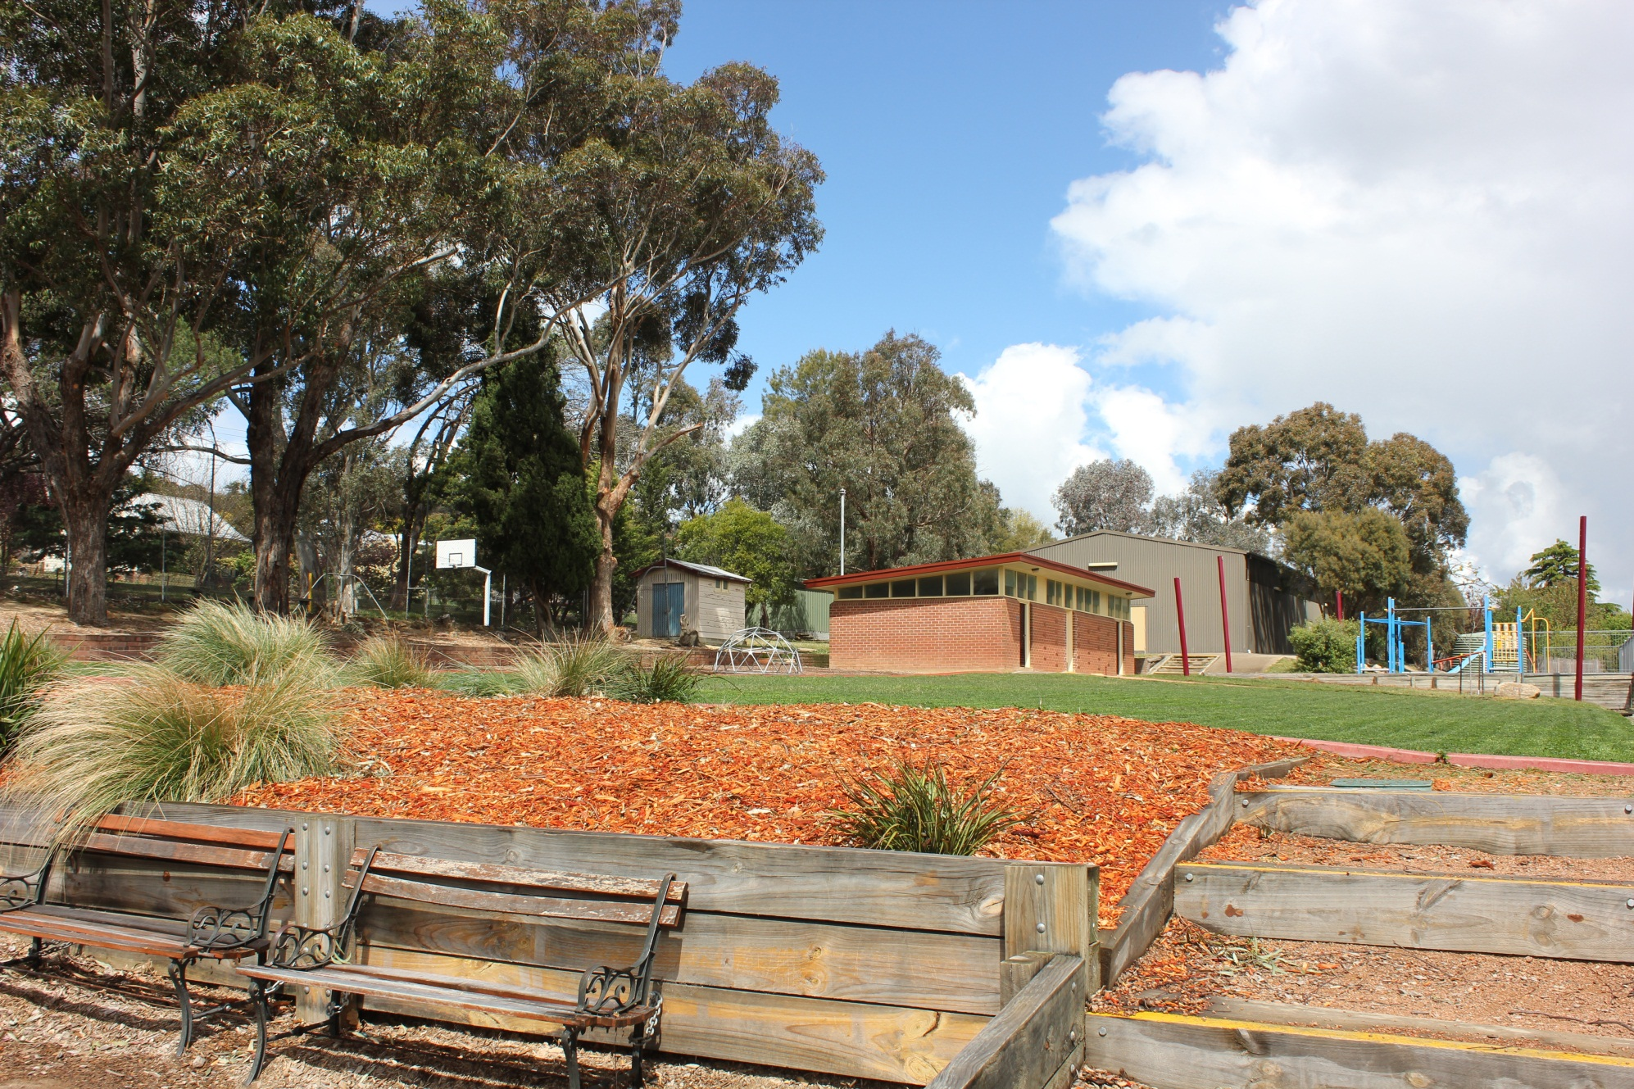
Tennis Court
Sports Shed
Hall/Canteen
Amenities

Slide 7
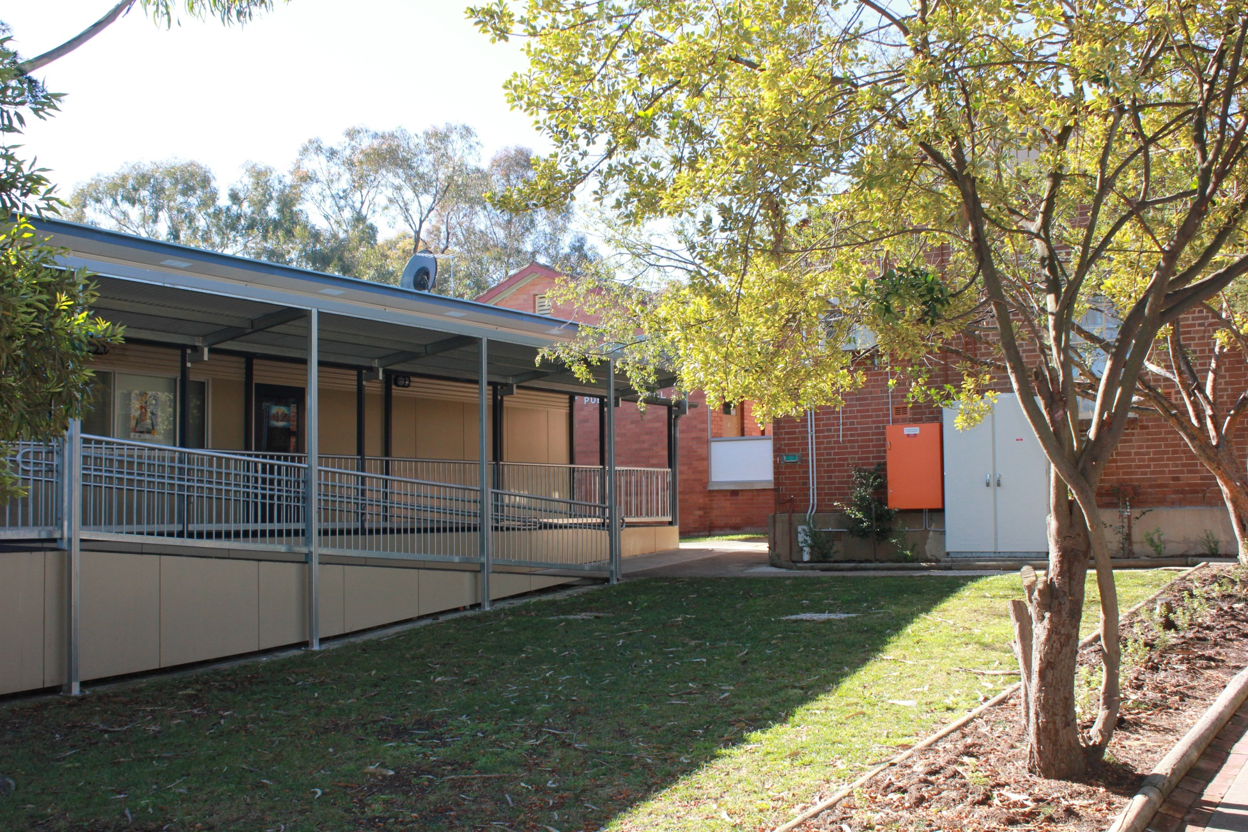
Library

Slide 8
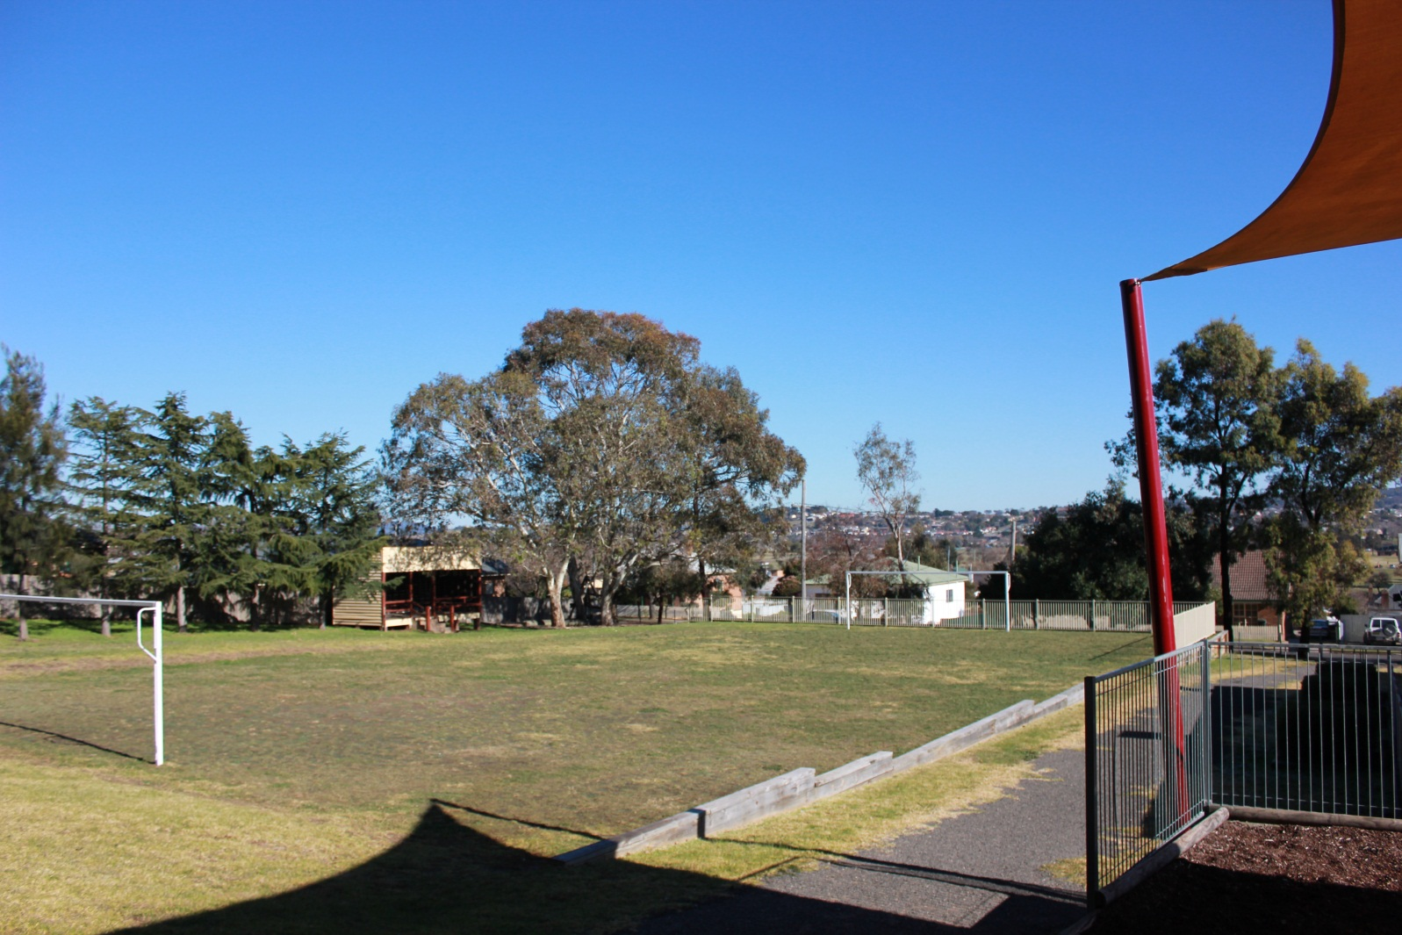
This is the bottom play area. It is referred to as ‘The Paddock’.

Slide 9
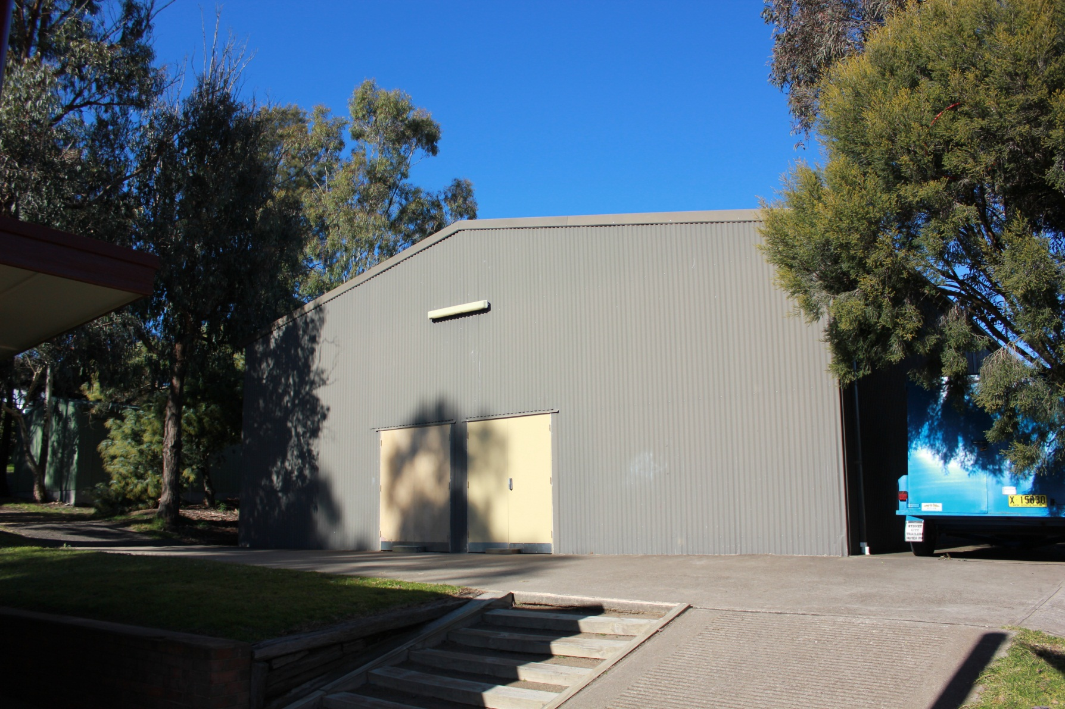
This is our ‘massive’ hall. It has a stage, storage areas and our canteen. We are really lucky to have such a fantastic space!

Slide 10
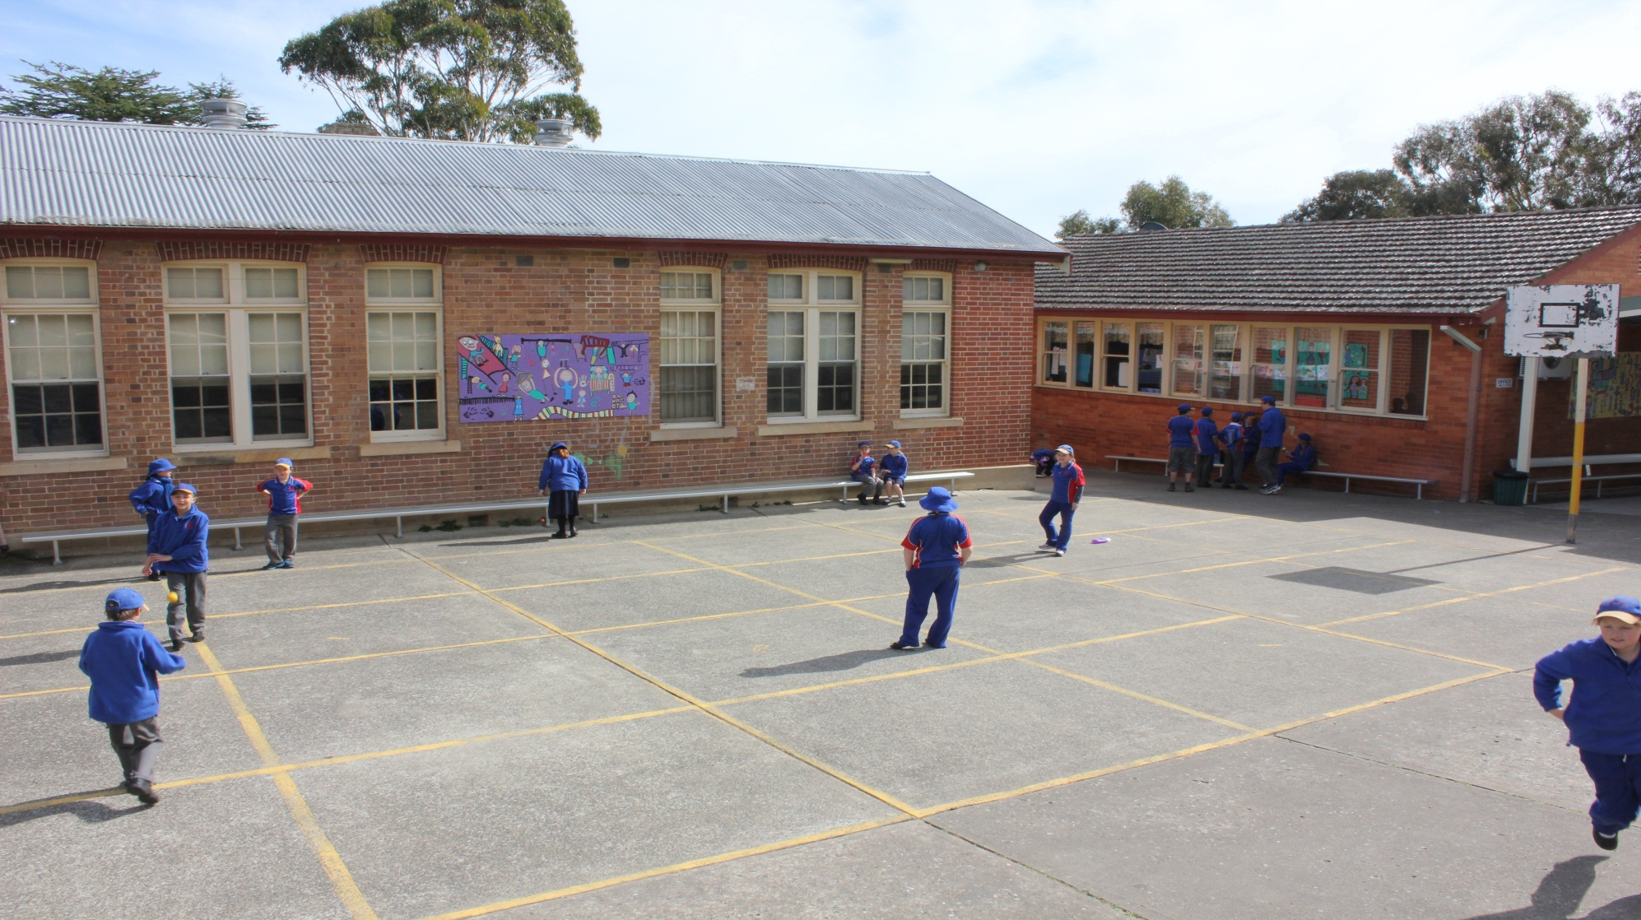
Handball Courts

Slide 11
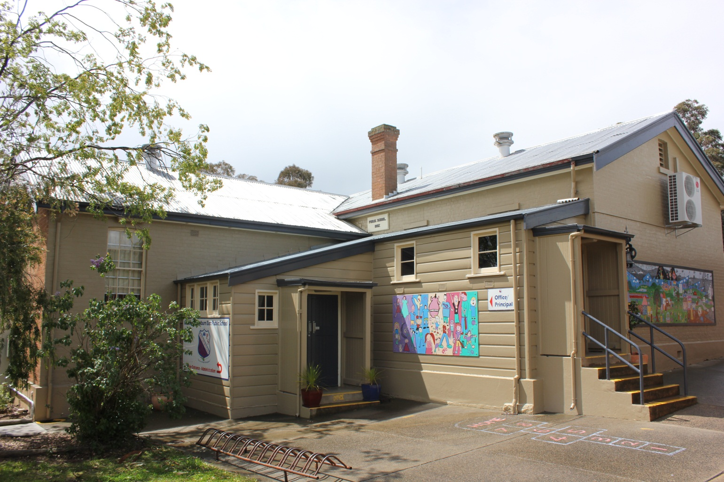
Administration Block This building was originally a classroom and library.

Slide 12
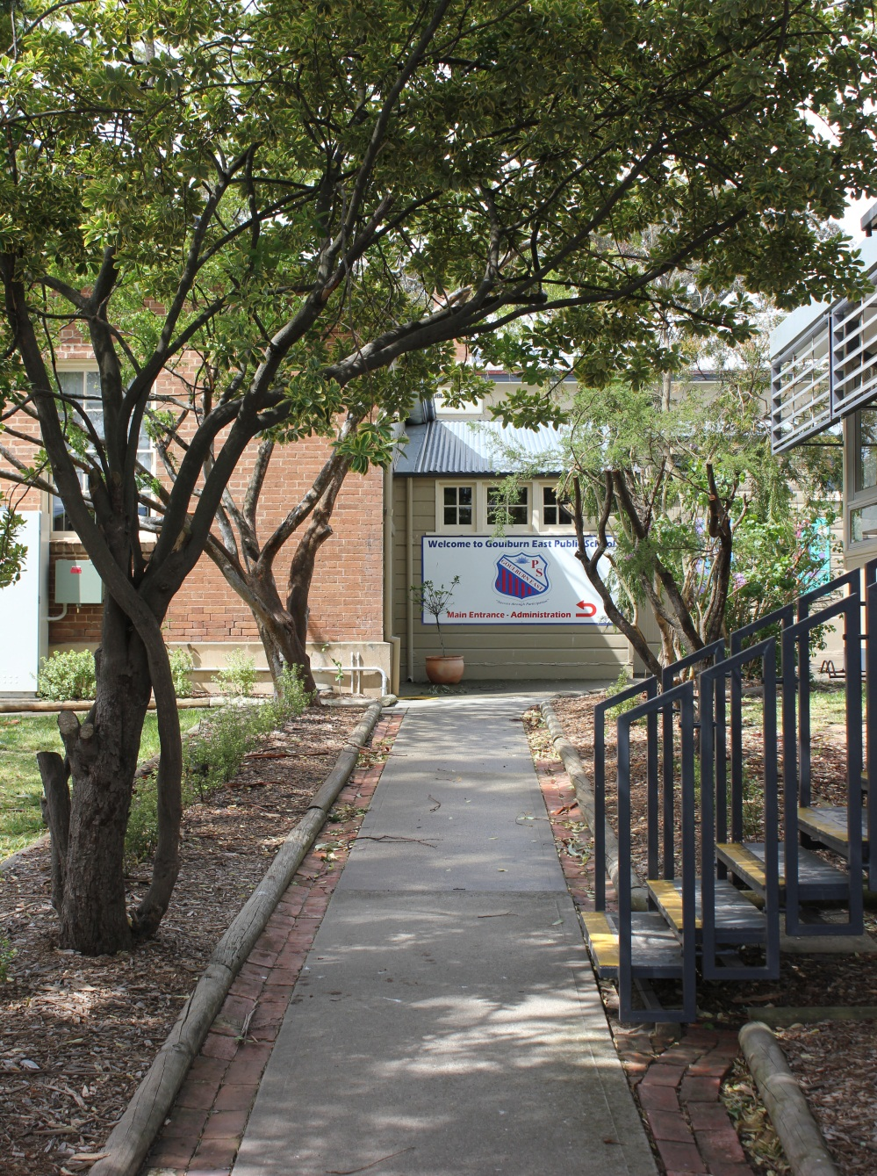
Entry via Eleanor St This entry leads straight to the Admin block and is our main entry.

Slide 13
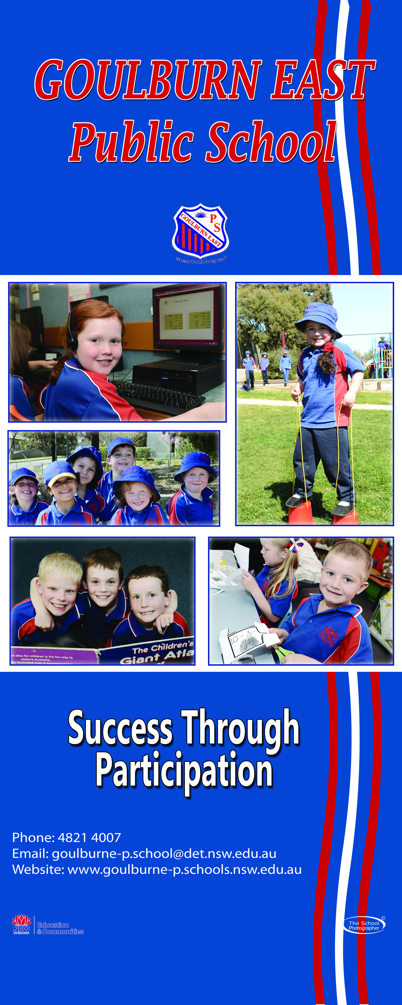
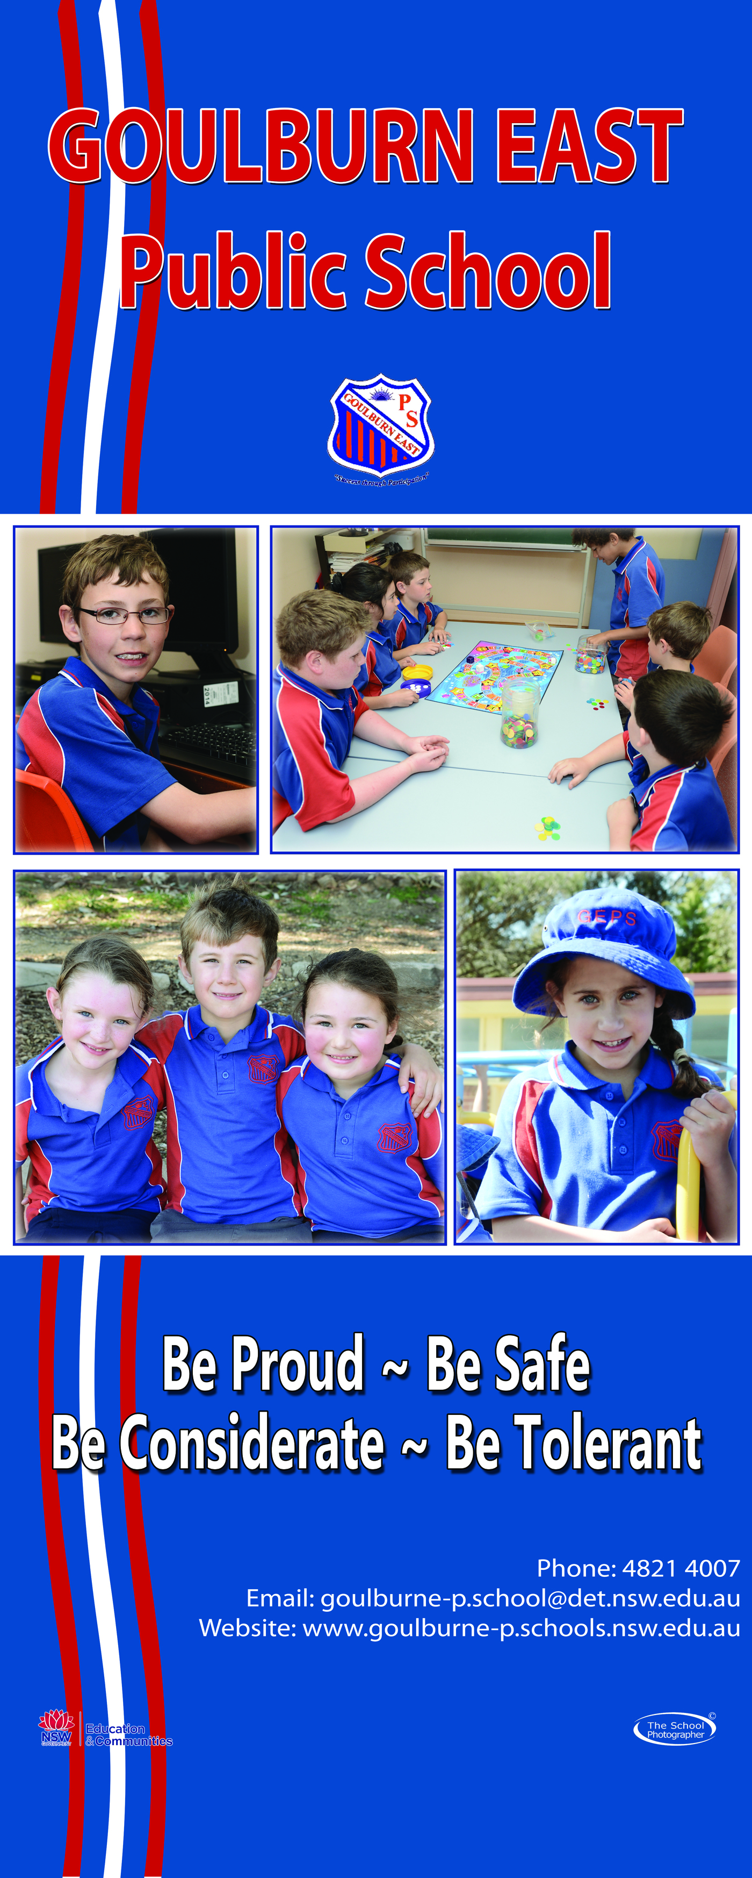
We are very proud of our beautiful school

